Slide 1
Introduction to PostgreSQL
John Martin & Grant Fritchey

Slide 2






About me
Ryan Booz
Redgate Advocate
@ryanbooz
/in/ryanbooz
www.softwareandbooz.com
youtube.com/@ryanbooz

Slide 3
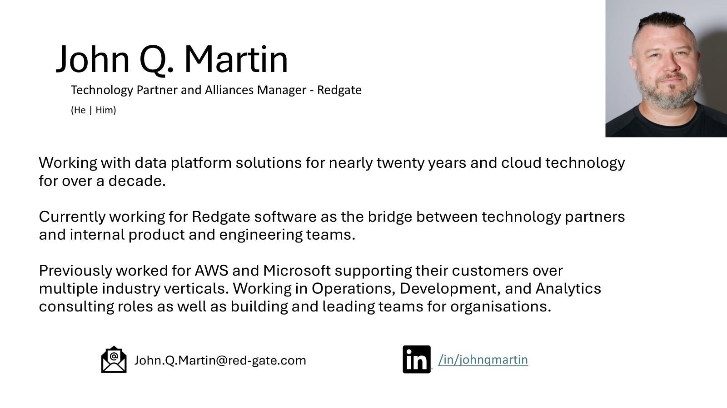

Slide 4

About me
Grant Fritchey
DevOps Advocate
Microsoft PostgreSQL MVP
AWS Community Builder
@gfritchey
Grant.Fritchey@Red-Gate.com
/in/gfritchey
scarydba.com

Slide 5

https://github.com/ScaryDBA/RedgatePrecon2025

Slide 6
Why PostgreSQL?

Slide 7

Licensing
Extremely permissive, open-source license
Core features can never be paywalled
Most extensions piggyback on the PostgreSQL License

Slide 8

Licensing
Extremely permissive, open-source license
Core features can never be paywalled
Most extensions piggyback on the PostgreSQL License

Slide 9

Licensing
Extremely permissive, open-source license
Core features can never be paywalled
Most extensions piggyback on the PostgreSQL License

Slide 10

This Photo by Unknown Author is licensed under CC BY

Slide 11

Extensibility
>30 hooks available to extensions
Any supported language, although SQL, C, and Rust are most popular
This Photo by Unknown Author is licensed under CC BY-NC

Slide 12
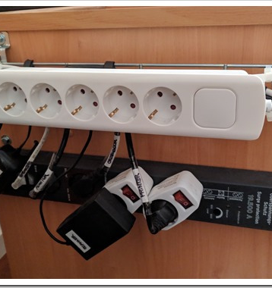
Extensibility
Not just for extending functionality
Package commonly used SQL functions/procedures
Versioning required and helpful
This Photo by Unknown Author is licensed under CC BY-NC-ND

Slide 13
Lay the Foundation

Slide 14
Instance = Cluster
SQL Server
PostgreSQL

Slide 15
User = Role
SQL Server
PostgreSQL

Slide 16
Transaction Log ≈ Write Ahead Log
SQL Server
PostgreSQL

Slide 17
Row = Row ∈ Tuple
SQL Server
PostgreSQL
PostgreSQL

Slide 18
[Table One] = "Table One"
SQL Server
PostgreSQL

Slide 19
BULK INSERT ≈ COPY
SQL Server
PostgreSQL

Slide 20
TOAST The Oversized-Attribute Storage Technique

Slide 21
Transaction Isolation
Read Committed
Repeatable Read
Serializable Read
Read Uncommitted (not supported)

Slide 22
PostgreSQL MVCC at a glance
Readers don't block writers
Tuples maintain on-row transaction visibility (xmin, xmax)
UPDATES always create new rows
Heap-only Tuples (HOT) attempts to mitigate some growth
Popular MVCC talk: https://www.youtube.com/watch?v=gAE_MSQtqnQ

Slide 23
MVCC at a glance
Readers don't block writers
Tuples maintain on-row transaction visibility values (xmin, xmax)
UPDATES always create new rows
Heap-only Tuples (HOT) attempts to mitigate some growth
Popular MVCC talk: https://www.youtube.com/watch?v=gAE_MSQtqnQ

Slide 24
Case Rules
Case sensitive string comparison (LIKE/ILIKE)
All object names are coerced to lower case
"Double quote" to qualify names
Prefer lower_snake_case

Slide 25
SQL Things

Slide 26
Case Rules
SQL Server
SELECT [Name]
FROM [Purchasing].[Vendor]
WHERE BusinessEntityID = 1492
Postgres
SELECT “Name”
FROM “Purchasing”.“Vendor”
WHERE “BusinessEntityID” = 1492;

Slide 27
Case Rules
SQL Server
SELECT [Name]
FROM [Purchasing].[Vendor]
WHERE BusinessEntityID = 1492
Postgres
SELECT name
FROM purchasing.vendor
WHERE business_entity_id = 1492;

Slide 28
LIMIT ≈ TOP
SQL Server
SELECT TOP(10) *
FROM [Purchasing].[Vendor]
Postgres
SELECT *
FROM purchasing.vendor
LIMIT 10;

Slide 29
LIMIT/OFFSET ≈ OFFSET/FETCH
SQL Server
SELECT *
FROM [Purchasing].[Vendor]
ORDER BY name
OFFSET 10 ROWS
FETCH 10 ROWS ONLY
Postgres
SELECT *
FROM purchasing.vendor
ORDER BY name
LIMIT 10 OFFSET 10;

Slide 30
ORDER/GROUP BY
SQL Server
SELECT SUBSTRING(name,1,1) nameCohort, SUM(amount) totalSales
FROM [Purchasing].[Sales]
GROUP BY SUBSTRING(name,1,1)
ORDER BY nameCohort, SUM(amount)
Postgres
SELECT SUBSTRING(name,1,1) name_cohort, SUM(amount) total_sales
FROM purchasing.sales
GROUP BY name_cohort
ORDER BY name_cohort, total_sales;

Slide 31
ORDER/GROUP BY
SQL Server
SELECT SUBSTRING(name,1,1) nameCohort, SUM(amount) totalSales
FROM [Purchasing].[Sales]
GROUP BY SUBSTRING(name,1,1)
ORDER BY nameCohort, SUM(amount)
Postgres
SELECT SUBSTRING(name,1,1) name_cohort, SUM(amount) total_sales
FROM purchasing.sales
GROUP BY 1
ORDER BY 1, 2;

Slide 32
DAY/MONTH/YEAR() ≈ DATE_PART()
SQL Server
SELECT COUNT(*), YEAR(OrderDate)
FROM Sales.Invoices
GROUP BY YEAR(OrderDate)
ORDER BY YEAR(OrderDate) DESC
Postgres
SELECT COUNT(*), DATE_PART(‘year’,order_date) order_year
FROM sales.invoices
GROUP BY order_year
ORDER BY order_year DESC;

Slide 33
SYSDATETIME() ≈ NOW()
SQL Server
SELECT SYSDATETIME();
Postgres
SELECT now();

Slide 34
Date Math & Intervals
SQL Server
SELECT COUNT(*), YEAR(OrderDate)
FROM Sales.Invoices
WHERE OrderDate > DATEADD(MONTH,-1,SYSDATETIME())
GROUP BY YEAR(OrderDate)
Postgres
SELECT COUNT(*), DATE_PART(‘year’,order_date) order_year
FROM sales.invoices
WHERE order_date > NOW() – INTERVAL ‘1 MONTH’
GROUP BY order_year;

Slide 35
LATERAL ≈ APPLY
CROSS/OUTER APPLY in T-SQL
Often used as an “optimization fence”
Outer query iterates an inner query
Helpful when JOIN isn’t possible
Retrieve top ordered row for each item in a list (ie. “most recent value for each item”)
Iterating a function that references the outer query
LATERAL JOIN allows the similar functionality

Slide 36
LATERAL ≈ APPLY
SQL Server
SELECT id, name, dayMonth, total
FROM Vendor v1
CROSS APPLY (
SELECT TOP(1) dayMonth, SUM(amount) total
FROM Sales
WHERE customerID = v1.id
GROUP BY dayMonth
ORDER BY SUM(amount) DESC
) s1

Slide 37
LATERAL ≈ APPLY
Postgres
SELECT id, name, day_month, total
FROM vendor v1
INNER JOIN LATERAL (
SELECT day_month, SUM(amount) total
FROM sales
WHERE customer_id = v1.id
GROUP BY day_month
ORDER BY total DESC
LIMIT 1
) on true s1;

Slide 38
Anonymous Code blocks
Default query language is SQL
Does not support anonymous code blocks
Variables
Loops
T-SQL like features
Requires DO blocks, Functions, or SPROCs
Default language is pl/pgsql ≈ T-SQL

Slide 39
Inline T-SQL vs pl/pgsql
SQL Server
DECLARE @PurchaseName AS NVARCHAR(50)
SELECT @PurchaseName = [Name]
FROM [Purchasing].[Vendor]
WHERE BusinessEntityID = 1492
PRINT @PurchaseName

Slide 40
Inline T-SQL vs pl/pgsql
Postgres
DO $$
DECLARE purchase_name TEXT;
BEGIN
SELECT name
FROM purchasing.vendor
WHERE business_entity_id = 1492 INTO purchase_name;
RAISE NOTICE ‘%’, purchase_name;
END;
$$

Slide 41
Functions
SQL Server
Postgres
Scaler
Table/Set Types
Triggers
Query planner tuning parameters
Any procedural language, but typically PL/pgSQL
Scaler
Inline Table Valued
Multi-statement Table Valued
No tuning hints for query planner
TSQL Only

Slide 42
Stored Procedures
SQL Server
Postgres
Complex logic
Multi-language
Contained in calling transaction scope
With some work, can return results
Complex logic
Multi-language
Can issue COMMIT/ROLLBACK and keep processing
Can return a single INOUT value
Introduced in PostgreSQL 11

Slide 43
Triggers
Functions applied to tables
INSERT/UPDATE/DELETE
BEFORE/AFTER/INSTEAD OF
ROW and STATEMENT
Conditional
NEW and OLD internal variables
…Reusable across tables!

Slide 44
Create Trigger Function
Postgres
CREATE OR REPLACE FUNCTION user_log()
RETURNS TRIGGER AS
$BODY$
BEGIN
INSERT INTO UserLog (Username, Message) VALUES (NEW.Username, NEW.Message)
END;
$BODY$
LANGUAGE plpgsql;

Slide 45
Apply Trigger
Postgres
CREATE TRIGGER tu_users
AFTER UPDATE
ON Users
FOR EACH ROW
WHEN (OLD.FirstName IS DISTINCT FROM NEW.FirstName)
EXECUTE PROCEDURE user_log();

Slide 46

DEMO!

Slide 47

PASS Session
The Accidental PostgreSQL DBA
📅 Thursday, Nov. 20
⌚ 10:15-11:15
🏢 Room 327-328

Slide 48
Installation

Slide 49
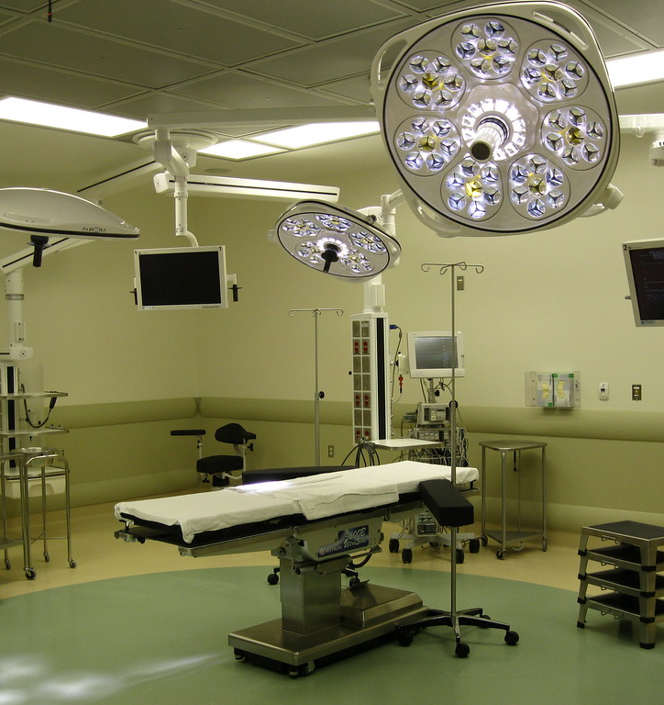
Supported Operating Systems
Linux
Windows
Containers
Cloud

Slide 50
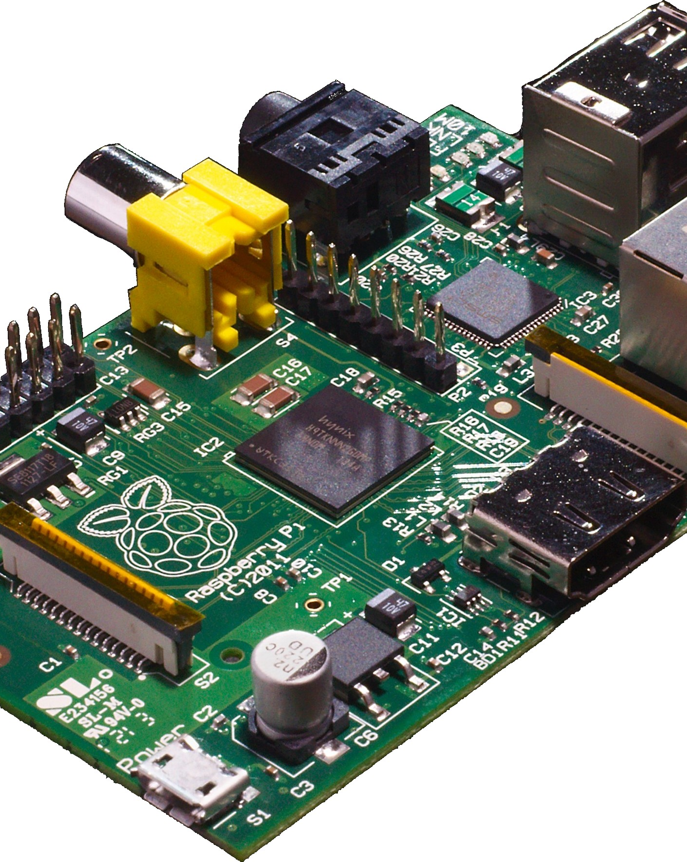
Minimum Hardware
Chip sets
x86 family
ARM
SPARC
PowerPC
S/390
MIPS
RISC-V
PA-RISC
Recommended Minimums
> 1ghz speed CPU
> 2gb memory
> 50kb storage

Slide 51
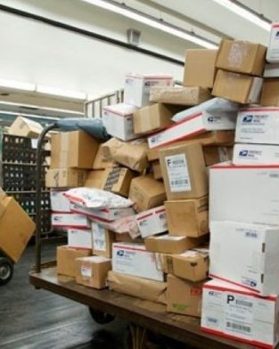
Packaged Bits
Core
For the “hackers”
Packages
OS
Special functions

Slide 52
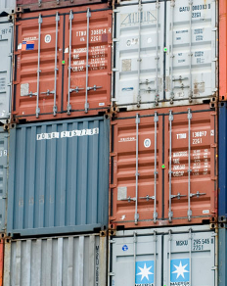
Containers
Easiest way to get started
Get in the habit of setting up volumes
Multiple forks available

Slide 53
DEMO!

Slide 54
https://github.com/ScaryDBA/RedgatePrecon2025

Slide 55
PostgreSQL Tools

Slide 56
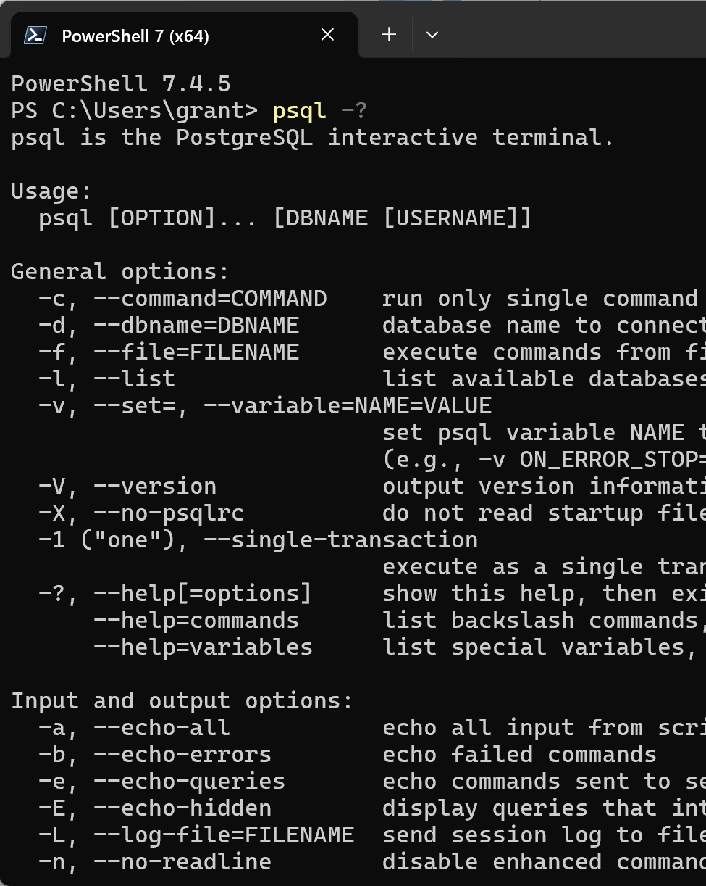
psql
Always available (almost)
Command line
Can work remote

Slide 57
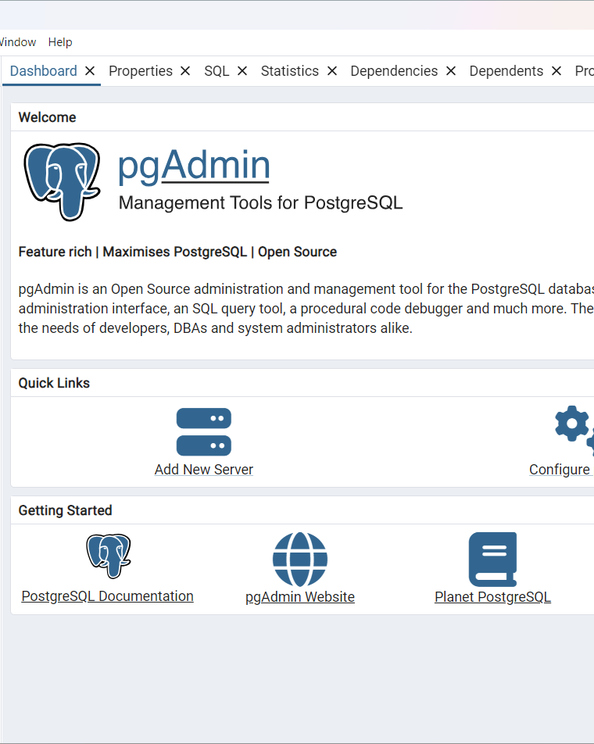
pgAdmin
Unofficial, "Official" PostgreSQL GUI
Not installed by default
Web version for remote work
Extensions

Slide 58

VS Code
PostgreSQL Plugin
Good for basics
Good integration with source control

Slide 59

DBeaver
Open source
Also paid
Multi-platform
Good and bad
Extensions
Some code completion

Slide 60
DEMO!

Slide 61
Databases

Slide 62

What Are Databases?
Primary means of organizing storage, access and behavior
Equivalent to SQL Server databases
Control storage
3 by default
postgres
template0
template1

Slide 63

Templates
Think, model db
template0 – leave this alone
template1 – customizable
Custom templates
You can choose the template

Slide 64

CREATE DATABASE
Defaults to template1
You can pick the template
You can define the owner

Slide 65

ALTER DATABASE
Change database behaviors
Change database properties
Modify behaviors of code and objects within database

Slide 66

DROP DATABASE
Boom!
IF EXISTS is a good idea
WITH (FORCE) is probably not

Slide 67
DEMO!

Slide 68
Restores and Backups

Slide 69
“You are only as good as your last restore”
Kimberly Tripp

Slide 70

Backups
pg_dump
pg_dumpall
pg_basebackup
Restore from dump
pg_restore

Slide 71
pg_dump
An export, not a true backup
Not transactionally aware
No point in time recovery
One database at a time
pg_dumpall

Slide 72
Common pg_dump Behaviors
-F – provides a file format, common to compress in tar file
-c – adds drop commands so you don’t have to drop & recreate the db (sometimes)
-a – data only
-s – schema only
-C – creates a database from dump

Slide 73
pg_basebackup
Backs up the server
Starting point for point in time recovery

Slide 74

WAL Archiving
Write Ahead Log (WAL)
Log backups for point in time recovery

Slide 75
WAL Archiving
WAL level
Replica
Logical
Archive mode enabled
Define archive command
File copy, but more

Slide 76
https://github.com/ryanbooz/bluebox
GitHub - ryanbooz/bluebox: An updated sample database for PostgreSQL, building off of the Pagila database

Slide 77
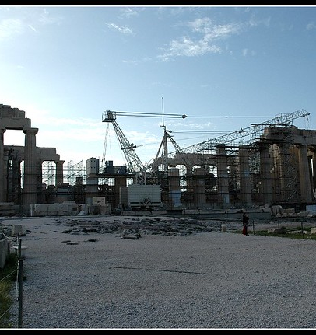
Restore
“Replay” a dump
pg_restore

Slide 78
Restore to Point In Time
Run pg_switch_wal
Stop the server
Clean data directory or make a new one
Restore the Base Backup files
Remove all files from pg_wal/
Edit postgresql.conf for restore command and point in time
Create a file called recovery.signal in the cluster data directory
Start the service

Slide 79
DEMO!

Slide 80
Database Objects

Slide 81

Data Types
Twenty (20) Categories of data types
Depending on how you count, ~125 data types
We won’t be listing them all

Slide 82
Common Data Types
Numeric
Integers, decimals & math
Character
No need for Unicode
Date/Time
Binary
Enums
Geometric
JSON
Array

Slide 83
Data Type Behaviors
Fixed or variable length, depending on type
Most can be NULL
DEFAULT values can be defined

Slide 84
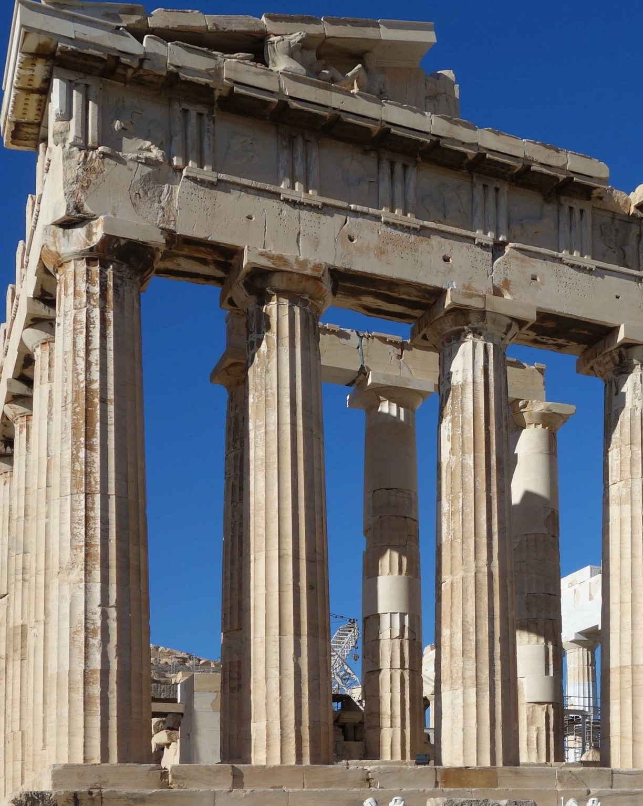
Tables and Columns
CREATE TABLE
Columns have defined data types
SERIAL vs. IDENTITY
Belongs to a schema
Owned by the creator, unless specified otherwise

Slide 85
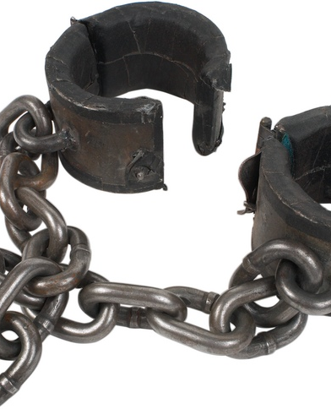
Constraints
NOT NULL
UNIQUE
Primary key
Foreign key
Check
Exclusion

Slide 86
Primary Key
Almost identical to a unique constraint
No NULL values
Defined by column, or by altering table

Slide 87
Foreign Key
Created against primary key or unique constraint
Enforces referential integrity
But NULL values can be equal
ON DELETE RESTRICT
CASCADE

Slide 88
Check Constraints
Enforced on FALSE evaluation
Which means NULL comparisons count as TRUE
Created with columns or ALTER TABLE

Slide 89
Exclusion Constraints
Similar to UNIQUE
Involves more complex comparisons
A strict equality comparison would be the same as UNIQUE

Slide 90

Indexes
PostgreSQL tables are heaps
No concept of a clustered index
CREATE and DROP CONCURRENTLY
Must be table owner to add indexes

Slide 91
Index Types
B-Tree
Hash
GiST
SP-GiST
GIN
BRIN

Slide 92

Views
Just a query
Treated as a table in SQL
Supports materialized views

Slide 93
DEMO!

Slide 94

PASS Session
Unlock PostgreSQL Performance:
A Guide to Index Types and
Their Proper Use
📅 Wednesday, Nov. 19
⌚ 2:30-3:45
🏢 Room 327-328

Slide 95
Procedural Languages

Slide 96
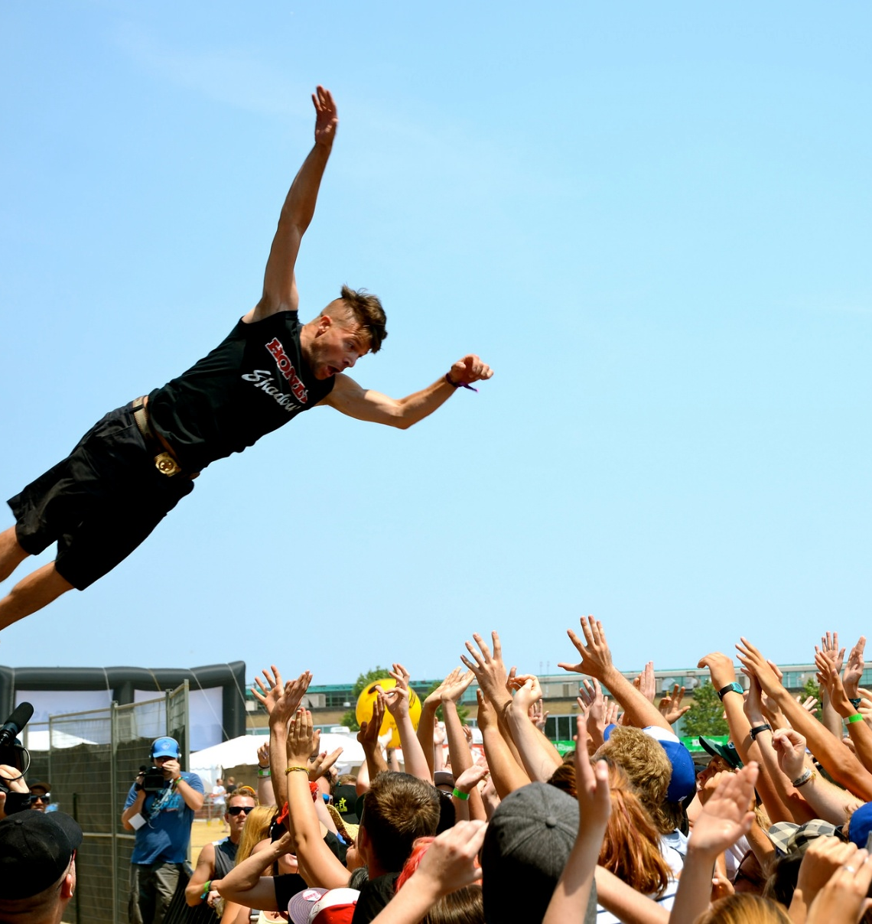
Trusted vs. Untrusted Languages
Trusted languages preserve security by preventing certain operations
DB internal processes
OS-level access
Non-privileged users can safely use
This Photo by Unknown Author is licensed under CC BY-SA

Slide 97
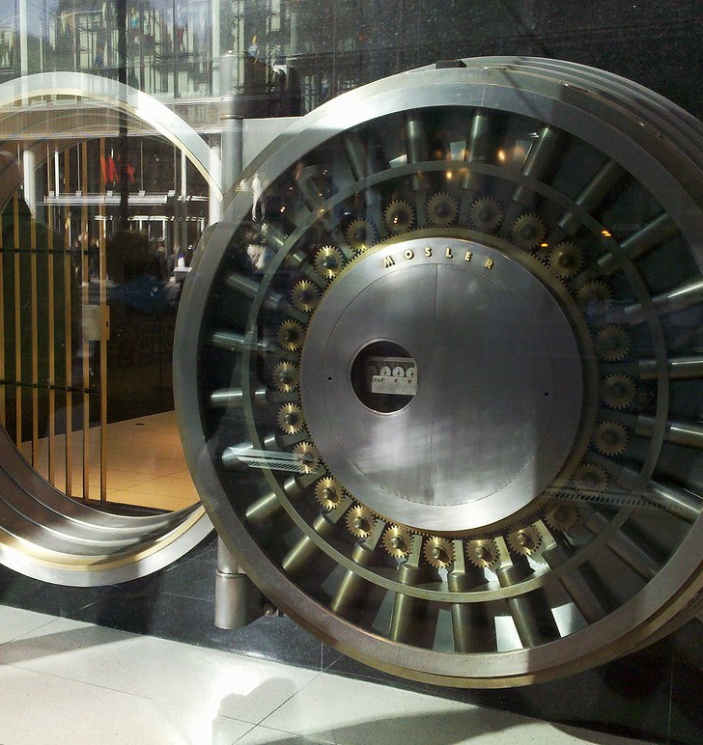
Trusted vs. Untrusted Languages
Untrusted languages do not provide security safeguards
Creator is responsible for security
Only superusers can create functions in untrusted languages
This Photo by Unknown Author is licensed under CC BY-SA-NC

Slide 98
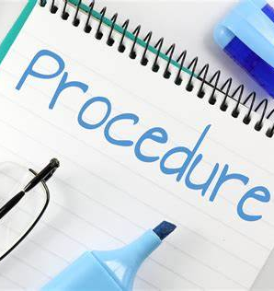
Core Procedural PostgreSQL Languages
SQL* (T)
PL/pgSQL (T)
PL/Python (U)
PL/TcL (T/U)
PL/Perl (T/U)

Slide 99

Lanauges Available by Extension
PL/Java (T/U)
pl/dotnet (U)
PL/Rust (T/U)
PL/R (U)
Pl/v8js (T)
This Photo by Unknown Author is licensed under CC BY-SA-NC

Slide 100

Core Functionality of Procedural Languages
Blocks
Variables
Error handling
If/Then
Case
Functions
Procedures

Slide 101

Functions
Implemented for returning data from PostgreSQL database
Similar to Oracle functions or SQL Server procedures

Slide 102
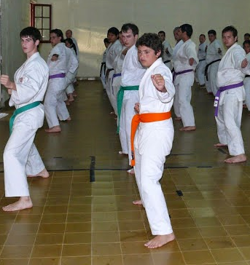
Function Basics
Use CREATE FUNCTION command
Provide a name
Define result set, value or record/tuple
Create a code block
Define language used

Slide 103

Function Behaviors
Code blocks
Dollar quoting, $$
Parameters
Variables

Slide 104
Function Example
CREATE FUNCTION genre_list ()
RETURNS TABLE (genre_id int, genre_name TEXT)
AS $$
BEGIN
RETURN QUERY
SELECT
fg.genre_id,
fg.name
FROM
public.film_genre AS fg;
END
$$ LANGUAGE plpgsql;

Slide 105
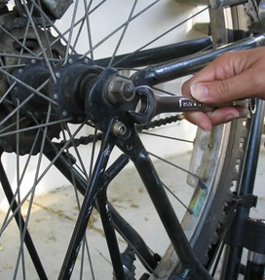
Using Functions
Treated like a table
SELECT
*
Column list
JOIN

Slide 106
Using Function Example
SELECT
gl.genre_id,
gl.genrename
FROM
genre_list() AS gl;

Slide 107

Function Query Planner Parameters
COST (100): estimated execution cost of the function
ROWS (1,000): estimated number of rows from the function

Slide 108

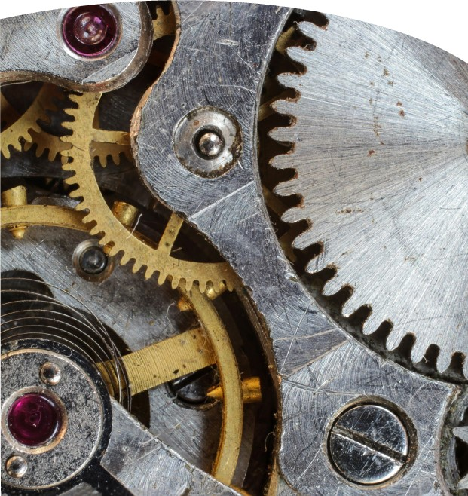
Function Query Planner Parameters
SET: modify session configuration
search_path is often set
PARALLEL {UNSAFE|SAFE}
Unsafe (default) forces serial execution plan
Safe allows the planner to consider parallel plans

Slide 109
Function Example
CREATE FUNCTION genre_list ()
RETURNS TABLE (genre_id int, genre_name TEXT)
COST 10000
ROWS 100000
AS $$
BEGIN
RETURN QUERY
SELECT
fg.genre_id,
fg.name
FROM
public.film_genre AS fg;
END
$$ LANGUAGE plpgsql;

Slide 110
Function Example
CREATE FUNCTION genre_list ()
RETURNS TABLE (genre_id int, genre_name TEXT)
SET search_path=bluebox,public
AS $$
BEGIN
RETURN QUERY
SELECT
fg.genre_id,
fg.name
FROM
film_genre AS fg;
END
$$ LANGUAGE plpgsql;

Slide 111
Procedures
Procedures are meant to perform actions, as opposed to functions, which return data
Similar to Oracle procedures, or SQL Server functions

Slide 112
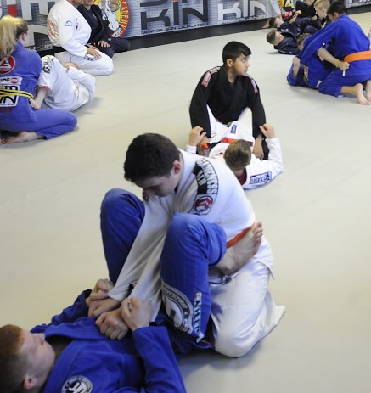
Procedure Basics
Use CREATE PROCEDURE command
Provide a name
Create a code block
Define language used

Slide 113
Procedure Example
CREATE OR REPLACE PROCEDURE new_genre (genrename TEXT)
AS $$
BEGIN
INSERT INTO bluebox.film_genre
(name) VALUES (genrename);
END
$$
LANGUAGE plpgsql;

Slide 114
INOUT Procedure Example
CREATE OR REPLACE PROCEDURE
genre_count(genreid int, INOUT genrecount int )
AS $$
BEGIN
SELECT count(*)
INTO genrecount
FROM
film AS f
WHERE genreid = ANY(f.genre_ids);
END
$$
LANGUAGE plpgsql;

Slide 115

Using Procedures
CALL
INOUT parameters

Slide 116
Using Procedures Examples
CALL new_genre('Anime');
DO $$
DECLARE genre_counts int;
BEGIN
CALL genre_count(genreid => 27, genrecount => genre_counts);
RAISE NOTICE 'Films in genre: %', genre_counts;
END $$

Slide 117

Subtransactions
Internal transactions are committed separately
Helpful for processing large batches of data over time
Checking progress
This Photo by Unknown Author is licensed under CC BY-SA
Notes:
A victor? Really?

Slide 118
Roles and Privileges

Slide 119
The Basics
Roles – The principle that can own objects and be granted permissions. E.g. Users & Groups
Privileges – The set of permissions that a role can be granted to objects in a database or cluster
Ownership – Every object in a cluster and database is owned by a role and carries a lot of power
Cluster - The instance of PostgreSQL that's running, each containing one or more databases. A server can have multiple, independent clusters
Database – The object we mostly care about. ;-) Also essential for database connections. Users connect to a database, not the cluster (specifically)

Slide 120

Server/Host (Firewall, Ports)
Cluster
Cluster
Cluster
Port: 5432
Port: 5433
Port: 5434
pg_hba.conf
pg_hba.conf
pg_hba.conf

Slide 121





Cluster
ROLES
Databases

Slide 122
pg_hba.conf
First layer of authentication
Similar to a firewall ruleset for PostgreSQL
Cloud vendors largely manage this for you
Which hosts & roles, can connect to what databases,
using what authentication method?

Slide 123
# Allow any user on the local system to connect to any database with
# any database user name using Unix-domain sockets (the default for local
# connections).
#
# TYPE DATABASE USER ADDRESS METHOD
local all all trust
# The same using local loopback TCP/IP connections.
#
# TYPE DATABASE USER ADDRESS METHOD
host all all 127.0.0.1/32 trust
# Allow any user from host 192.168.12.10 to connect to database
# "postgres" if the user's password is correctly supplied.
#
# TYPE DATABASE USER ADDRESS METHOD
host postgres all 192.168.12.10/32 scram-sha-256
https://www.postgresql.org/docs/current/auth-pg-hba-conf.html

Slide 124
Roles
Own databases, schemas, and objects
Tables, Functions, Views, Etc.
Have cluster-level privileges (attributes)
Granted privileges to databases, schemas, and objects
Can possibly grant privileges to other roles

Slide 125
PostgreSQL 15 Attributes
LOGIN
SUPERUSER
CREATEROLE
CREATEDB
REPLICATION LOGIN
PASSWORD
INHERIT
BYPASSRLS
CONNECTION LIMIT

Slide 126
Users and Groups
Semantically the same as roles
By Convention:
User = LOGIN
Group = NOLOGIN
PostgreSQL 8.2+ CREATE (USER|GROUP) is an alias

Slide 127
CREATE USER user1 WITH PASSWORD 'abc123' INHERIT;
CREATE GROUP group1 WITH INHERIT;
CREATE ROLE user1 WITH LOGIN PASSWORD 'abc123’ INHERIT;

Slide 128
PostgreSQL Superuser
🦸is created by default when the cluster is initialized
Typically named postgres because the system process user initiates a initdb
Bypasses all security checks except LOGIN
Full privilege to do "anything"
Treat superuser with care (like root on Linux)

Slide 129
Most cloud providers do not provide superuser access

Slide 130
Superuser-like
Create a role with the right level of control
Recommend adding CREATEROLE and CREATEDB
Allows user management and database ownership
May still limit some actions (e.g. installing extensions limited to superuser)

Slide 131
PostgreSQL 15+ Privileges
SELECT
INSERT
UPDATE
DELETE
TRUNCATE
REFERENCES
TRIGGER
CREATE
CONNECT
TEMPORARY
EXECUTE
USAGE
SET
ALTER SYSTEM

Slide 132
PUBLIC Role
All roles are granted implicit membership to PUBLIC
The public role cannot be deleted
Granted CONNECT, USAGE, TEMPORARY, and EXECUTE by default
<=PG14: CREATE on the public schema by default
>=PG15: No CREATE on public schema by default

Slide 133
Granting Privileges
-- grant the ability to create a schema
GRANT CREATE ON DATABASE app_db TO admin1;
-- see and create objects in schema
GRANT USAGE,CREATE IN SCHEMA demo_app TO dev1;
-- allow some roles only some privileges
GRANT SELECT,INSERT,UPDATE
ON ALL TABLES IN SCHEMA demo_app TO jr_dev;

Slide 134
Granting Privileges
Remember, explicit grants only effect existing database objects!
-- This will only grant to existing objects
GRANT ALL TO ALL TABLES IN SCHEMA public TO dev1;

Slide 135
More Detail on GRANT and REVOKE
What the privileges mean:
https://www.postgresql.org/docs/current/ddl-priv.html
How to GRANT privileges:
https://www.postgresql.org/docs/current/sql-grant.html
How to REVOKE privileges:
https://www.postgresql.org/docs/current/sql-revoke.html

Slide 136
DEMO!

Slide 137
https://github.com/ScaryDBA/RedgatePrecon2025

Slide 138
MVCC and Vacuum

Slide 139
"MVCC Unmasked" by Bruce Momjian
Portions of this content were sourced from Bruce's seminal talk, "MVCC Unmasked", under the Creative Commons Attribution License.
https://momjian.us/main/writings/pgsql/mvcc.pdf

Slide 140
PostgreSQL documentation uses the word tuple for row. In technical terms, a tuple is an instance of the row schema.

Slide 141
Multi-Version Concurrency Control (MVCC) is what allows PostgreSQL (and other databases) to support highly concurrent workloads with the goal that:
"readers never block writers,
and writers never block readers"

Slide 142
Multi-Version Concurrency Control
For the default Read Committed Isolation Level:
Each query only sees transactions that were committed before it started (ID less than current transaction)
At the beginning of a query, PostgreSQL records:
The transaction ID (xid) of the current command
All transaction IDs that are in process
Multi-statement transactions also record any of their own completed statements from earlier in transaction

Slide 143
Assigning XIDs
In PostgreSQL, transaction IDs are assigned when the first command/statement is run within a transaction, not when BEGIN is executed.

Slide 144
INSERT
xmin = current transaction ID
xmax = zero (invalid)
xmin | xmax | User Data
48 | 0 | Hello!

Slide 145
DELETE
xmin is unchanged
xmax = current transaction ID
Dead Tuple
xmin | xmax | User Data
48 | 78 | Hello!

Slide 146
UPDATE
Original tuple:
xmin is unchanged
xmax = current transaction ID
New tuple:
xmin = current transaction ID
xmax = zero
Dead Tuple
xmin | xmax | User Data
48 | 78 | Hello!
78 | 0 | Hello World!

Slide 147
UPDATE (with the same value)
Original tuple:
xmin is unchanged
xmax = current transaction ID
New tuple:
xmin = current transaction ID
xmax = zero
Dead Tuple
xmin | xmax | User Data
48 | 78 | Hello!
78 | 0 | Hello!

Slide 148
Visible Tuples
A tuple is considered "visible" when creation XID (xmin):
is a committed transaction
is less than the XID stored at the start of the current query
was not in-process at the start of the current query
Visible tuples must also have an expired XID (xmax) that:
is blank or aborted or
is greater than the transaction counter stored at query start or
was in-process at query start

Slide 149
Tuple Visibility and Snapshots
Created rows only
Snapshot
Highest committed XID = 90
Open transactions: 20,50,100
Current XID = 110
xmin | xmax | User Data
10 |  | Hello!
50 |  | Velkommen
100 |  | willkommen
Visible
Not Visible
Not Visible
Updated rows
xmin | xmax | User Data
10 | 70 | Hello!
40 | 50 | Velkommen
48 | 100 | willkommen
Not Visible
Visible
Visible

Slide 150
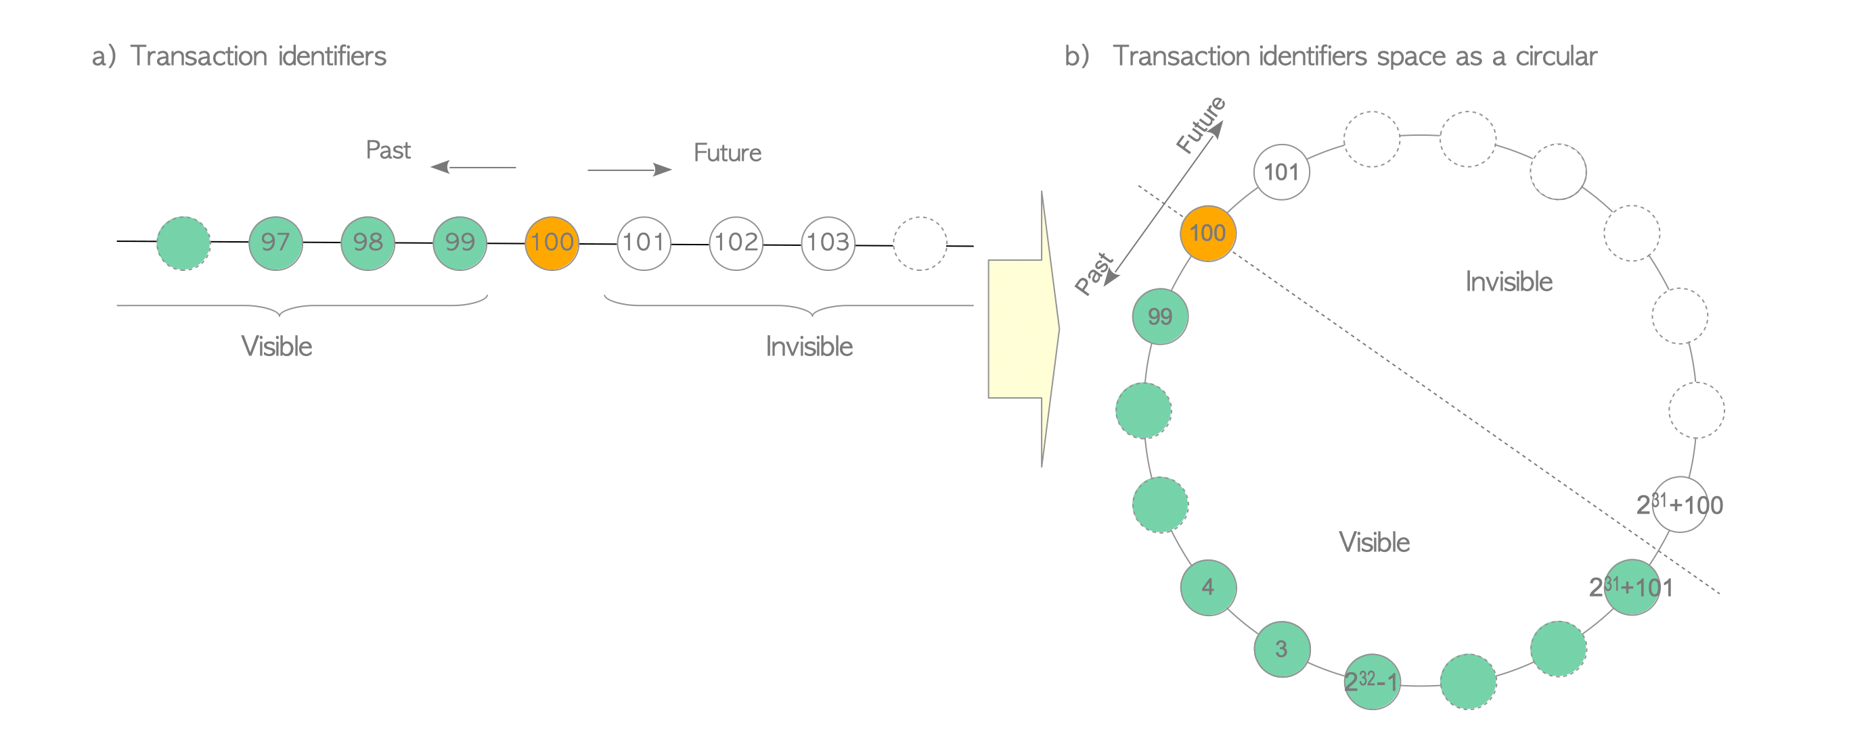
XIDs are stored as INT (32-bit)
Compared using modulo-2³²
2.1 billion XIDs in the "past"
2.1 billion XIDs in the "future"
Image Credit: https://www.interdb.jp/pg/pgsql05.html

Slide 151
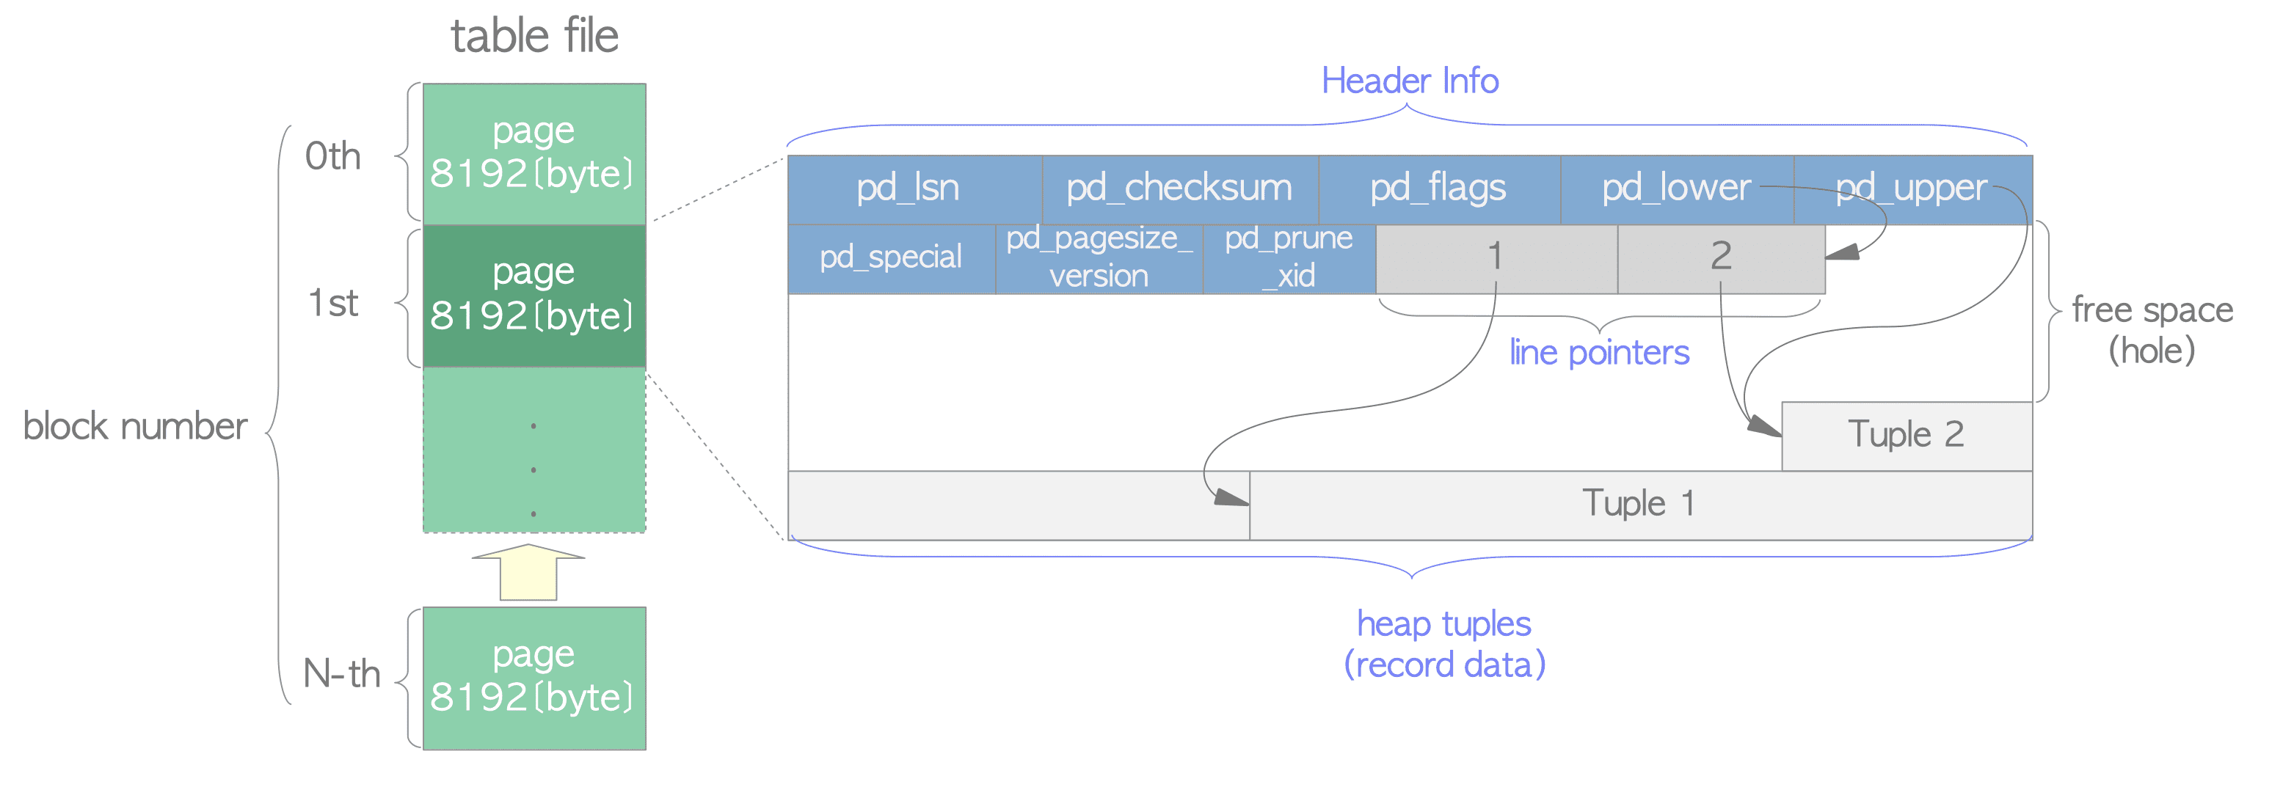
PostgreSQL Heap Page Layout
Image credit: https://www.interdb.jp/pg/pgsql01.html

Slide 153
PostgreSQL Heap Page Layout

Slide 155
Index
lp1
lp2
lp1
lp2
lp3
Tuple 2
Tuple 3
Tuple 2
Tuple 1
Tuple 1

Slide 156
Index
lp1
lp2
(dead)
(dead)
lp3
Tuple 2
Tuple 3
(dead)
Tuple 1
(dead)

Slide 157
Index
lp1
lp2
(dead)
(dead)
lp3
lp4
Tuple 2
Tuple 4
Tuple 3
(dead)
Tuple 1
(dead)

Slide 158
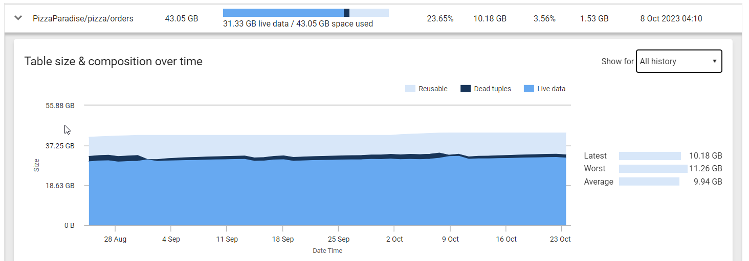

Slide 160
Sequential Scan
xmin | xmax | ID | User data…
SELECT a, b, c FROM t;

Slide 161
Index
Sequential Scan
xmin | xmax | ID | User data…
SELECT a, b, c FROM t
WHERE ID=10;

Slide 162
Index
xmin | xmax | ID | User data…
Index Scan
SELECT a, b, c FROM t
WHERE ID=10;

Slide 163
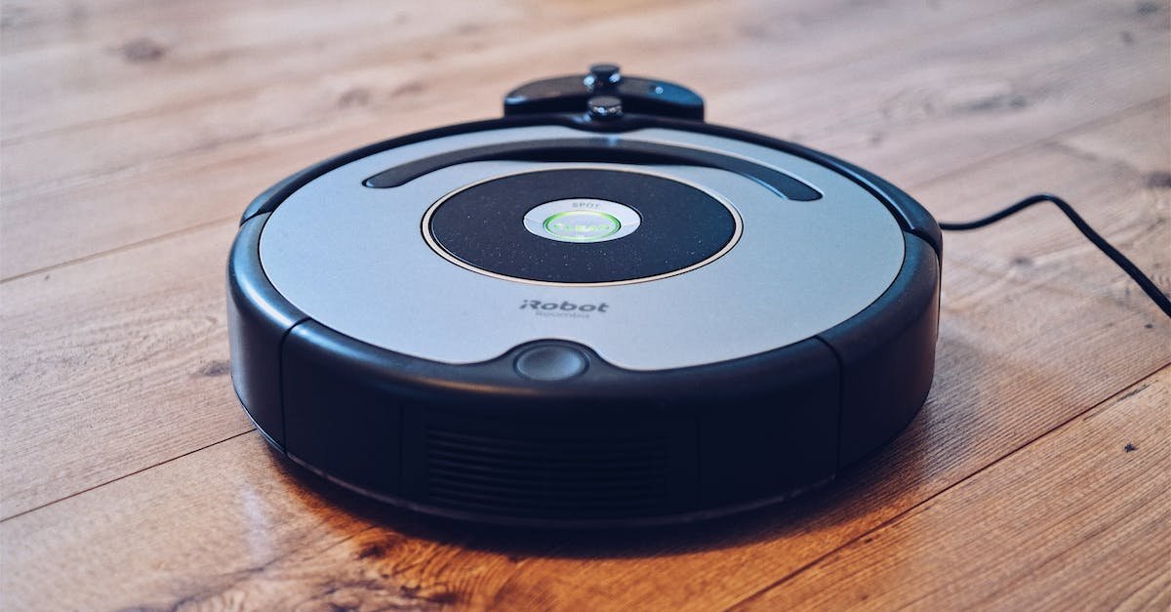
Insert image of vacuum!

Slide 164
Vacuum!
Serves two main purposes:
Free up space on pages used by dead tuples
Mark rows as "frozen" if they have a XID sufficiently older than the most recent XID, allowing the XID to be reused again in the future
Additionally, if all rows on a page are frozen, the page can be marked frozen to speed up scans

Slide 165
Free space used by dead tuples

Slide 166
Index
lp1
lp2
(dead)
(dead)
lp3
lp4
Tuple 2
Tuple 4
Tuple 3
(dead)
Tuple 1
(dead)

Slide 167
Index
lp1
lp2
(dead)
(dead)
lp3
lp4
Tuple 2
Tuple 4
Tuple 3
(dead)
Tuple 1
(dead)

Slide 168
Index
lp1
lp2
(unused)
(unused)
lp3
lp4
Tuple 2
Tuple 1
Tuple 4
Tuple 3

Slide 170
Freeze rows and pages

Slide 171
lp1
lp2
lp3
lp4
lp5
lp6
Tuple 6
Tuple 5
Tuple 4
❄️
❄️
Tuple 3
Tuple 2
❄️
Tuple 1

Slide 172
❄️
lp1
lp2
lp3
lp4
lp5
lp6
Tuple 6
Tuple 5
Tuple 4
Tuple 3
Tuple 2
Tuple 1

Slide 173
VACUUM Automation
Vacuuming is so vital that there is an automated process called autovacuum
Triggered based on a percentage of dead tuples/modified data (generally)
Individual DELETE or UPDATE heavy tables can be tuned directly

Slide 174
Individual Table Auto[vacuum/analyze]
Autovacuum triggers at 20% data modification
Autoanalyze triggers at 10% data modification
Analogous to TF-2731, but per table!

Slide 175
Global Autovacuum and Autoanalyze Settings
"Scale Factor" = Percentage of rows modified before process runs
"Threshold" = Added number of rows to add to the percent calculation.
(this prevents very small tables from taking resources)
autovacuum_vacuum_scale_factor = 0.2 (20%)
autovacuum_vacuum_threshold = 50
autovacuum_analyze_scale_factor = 0.1 (10%)
autovacuum_analyze_threshold = 50

Slide 176
Analyze at 5% modification:
ALTER TABLE t SET (autovacuum_vacuum_scale_factor=0.05)
Analyze threshold above percentage:
ALTER TABLE t SET (autovacuum_vacuum_threshold=500)

Slide 178
"If you think autovacuum/analyze is running too frequently, it's probably not running frequently enough"

Slide 179
Standard Configuration and Maintenance

Slide 180
Over 300 configuration options

Slide 181
Configuration
Every non-serverless Postgres should be tuned
Edit postgresql.conf
Helpful Tuning Resources
https://wiki.postgresql.org/wiki/Tuning_Your_PostgreSQL_Server
https://www.youtube.com/watch?v=IFIXpm73qtk
https://postgresqlco.nf/

Slide 182
Configuration – The Big 4
shared_buffers:
data cache
at least 25% of total RAM
work_mem:
max memory for each plan operation
JOINS, GROUP BY, ORDER BY can all have workers

Slide 183
shared_buffers
Configurable memory reserved for data cache
Start at 25% of total server memory
Keep a watch on Cache Hit Ratio
<90% consistently, increase shared_buffers or increase instance resources

Slide 184
Cache Hit Ratio
SELECT
sum(heap_blks_read) as heap_read,
sum(heap_blks_hit) as heap_hit,
sum(heap_blks_hit) / (sum(heap_blks_hit) +
sum(heap_blks_read)) as ratio
FROM
pg_statio_user_tables;

Slide 185
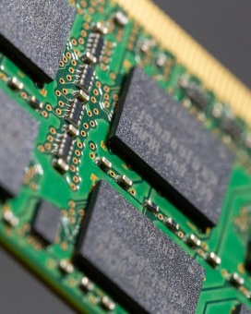
work_mem
Single most important setting for complex workloads*
Memory used by query operations like sorting and hashing
*It Depends…

Slide 186
work_mem
Postgres doesn't pre-allocate memory before running a query (i.e. memory grant)
When you see "external disk" operations in query plans, work_mem likely needs to be increased
4MB default, typically tune higher (8/16MB)
Set on individual query sessions when necessary

Slide 187
Configuration – The big 4
maintenance_work_mem:
memory for background tasks like VACUUM and ANALYZE
Index maintenance tasks
max_connections:
Defaults to 100
Many providers start at 200
Total memory usage equals: max_connections * work_mem * hash/sort operation

Slide 188
maintenance_work_mem
maintenance_work_mem is the amount of RAM that a maintenance process like autovacuum can use to process pages of data. If it is not sufficient, vacuuming (and other essential maintenance processes) will take more time and fall behind.
If autovacuum isn't completing it's work regularly, check this setting!
Default setting = 64MB

Slide 189
autovacuum_work_mem
Amount of memory used by each autovacuum process
Correlated to autovacuum_max_workers
Tune if maintenance_work_mem is increased dramatically (>=1GB)
Default setting = maintenance_work_mem

Slide 190
Configuration (other)
wal_compression:
Off (default)
Default uses pglz
PG15 can use lz4 or zstd
autovacuum:
On (default)
Do not turn off
Might have to tune individual tables

Slide 191
Configuration (other)
autoanalyze:
On (default)
Do not turn off
Might have to tune individual tables
default_toast_compression:
pglz (default)
Consider lz4 instead

Slide 192
Configuration (other)
random_page_cost:
"scale" of cost for random page access
Defaults to 4.0 – spinning rust
Increases likelihood of table scans
Change to 1.0 in most environments and monitor

Slide 193
SHOW & SET
SHOW will display the current value
SET allows settings to be modified (when possible)
Examples:
SHOW ALL – page all settings
SHOW max_connections - configured connection limit

Slide 194
Other Maintenance Tasks

Slide 195
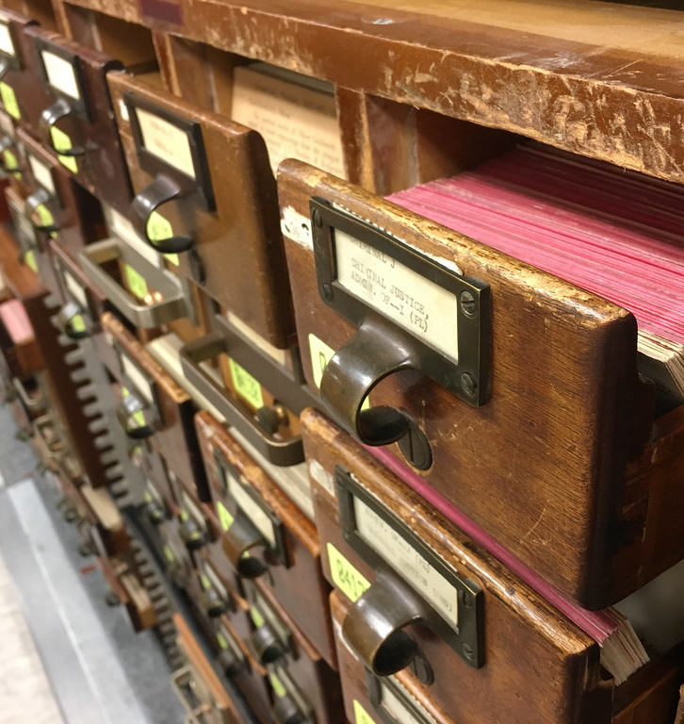
Reindexing
Indexes can have bloat, too
Reindexing consolidates and cleans index pages
Requires access exclusive lock, unless CONCURRENTLY is used
This Photo by Unknown Author is licensed under CC BY-NC

Slide 196
Reindexing
Maintains FILLFACTOR when reindexing
Essential upkeep for some specific index types like BRIN
This Photo by Unknown Author is licensed under CC BY-NC

Slide 197

FILLFACTOR
The target amount of free space left on each data page
Defaults:
Tables = 100%
Indexes = 90%
Very important consideration for update-heavy tables

Slide 198
FILLFACTOR
For indexes
For tables
Higher value when indexed columns will not change (i.e. timestamps or counters)
Lower value when data inserts will likely produce many page splits
Higher value for insert-only workloads
Lower value for update heavy tables
Remember, every update produces a new row version

Slide 199
Heap-only Tuples (HOT)
HOT updates attempt to store new row version on the same data page
Index pointer does not have to change
Updated value cannot be referenced by an index
Increase likelihood by decreasing FILLFACTOR
Benefits update-heavy tables

Slide 200
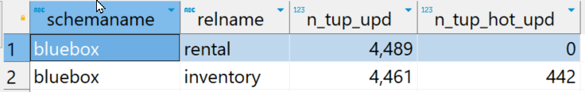
SELECT schemaname, relname,
n_tup_upd, n_tup_hot_upd
FROM pg_stat_user_tables;

Slide 201
Extensions

Slide 202





Customizable with Extensions

Slide 203
What are extensions?
Non-core code that can be installed into a database
Add new functions or features
Modify PostgreSQL runtime based on hooks within the code
Query planner
Data retrieval
Storage engine
More…

Slide 204
What are extensions?
Written in any supported language, including SQL
Many popular extensions are written in C to gain the best performance
The pgrx framework is a popular Rust-based toolchain for building extensions

Slide 205
Problems that extensions can solve
Having a repeatable set of functions available in a database for DBAs within your company
Providing access to server data that hasn't been exposed yet
Modifying data storage
Influencing the query planner

Slide 206
If you wish PostgreSQL could do something, it's probably possible with an extension… within reason

Slide 207



TimescaleDB
Citus
PostGIS

Slide 208
What are extensions?
Extensions must be installed per-database
There are no "server-level" extensions
PostgreSQL ships with 'contrib' extensions
Others must be installed on the server
Manually (source, RPM/YUM packages)
PostgreSQL Extension Network (PGXN)
Trusted vs. Untrusted

Slide 209
Extensions
See available extensions
Install
Update
Uninstall
SELECT * FROM pg_available_extensions ORDER BY name;
CREATE EXTENSION pg_stat_statements;
ALTER EXTENSION pg_stat_statements UPDATE;
DROP EXTENSION pg_stat_statements;

Slide 210
Support varies among cloud providers

Slide 211
10 Extensions to know about

Slide 212
PostGIS
Industry-standard, open-source, geographic database
Adds geographic:
Types: point, line, polygon
Indexes: GIN, GIST, SPGIST, BRIN
Functions: hundreds of "ST_..." functions

Slide 213
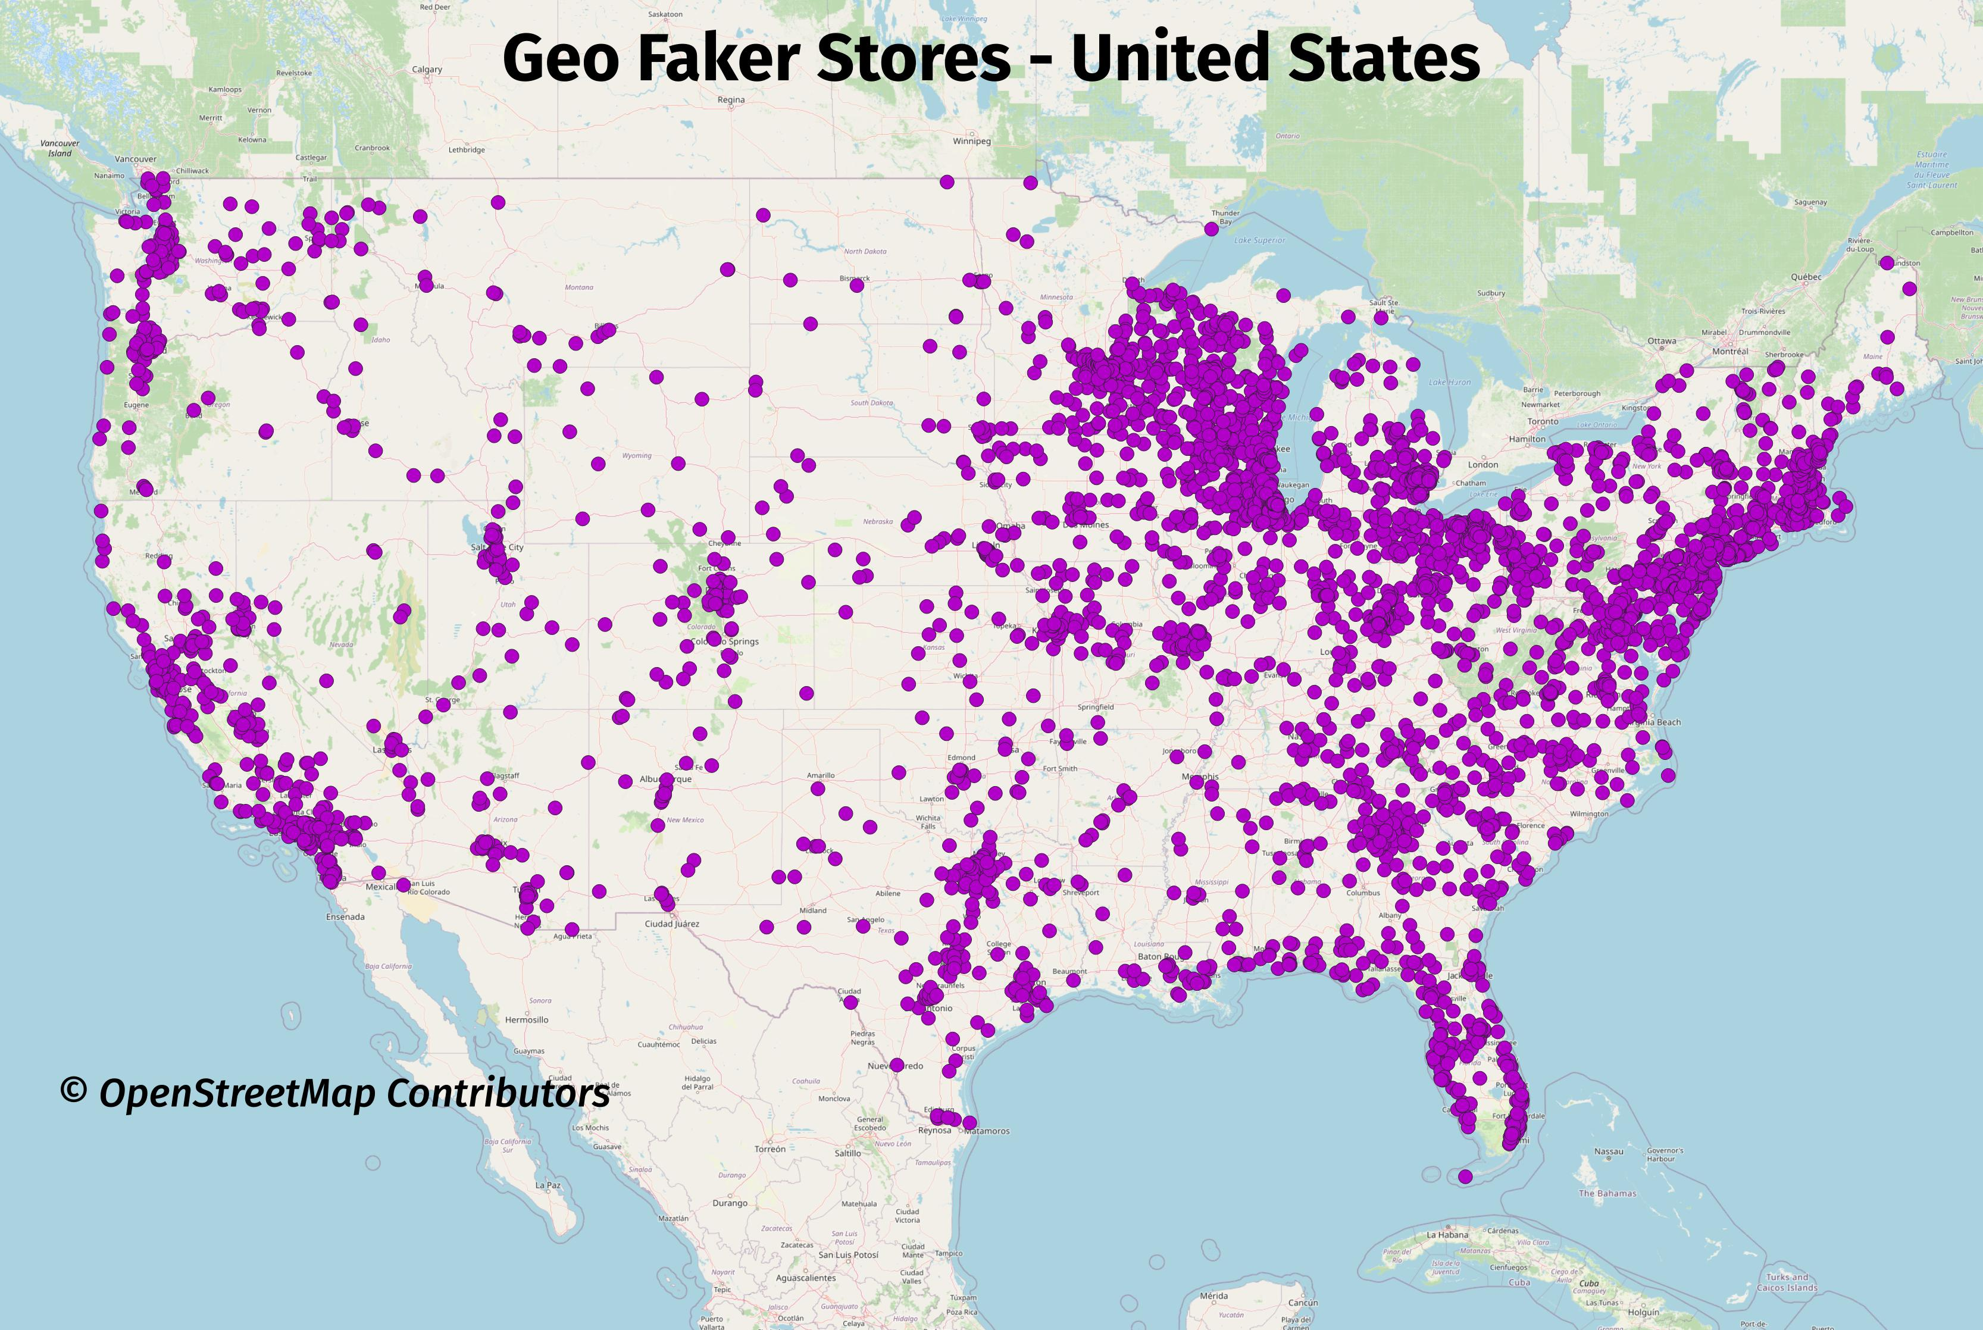

Slide 214
postgres_fdw
contrib
Foreign Data Wrapper (FDW) is a standards-compliant connection infrastructure
Initiates a connection to an external PostgreSQL database
Necessary for cross-database and cross-instance queries
There is no fully-qualified notation to access other databases

Slide 215
pg_stat_statements
contrib
One of many statistics views within PostgreSQL
Data is stored by PostgreSQL, view provides access to the data
Matches counts for parameterized versions of queries
Cumulative only, requiring tooling to store snapshots over time
Installed by default on all major cloud providers

Slide 216
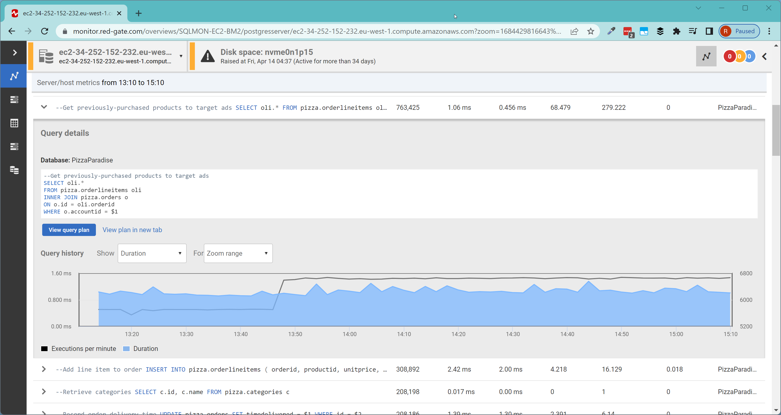
Redgate Monitor

Slide 217
pg_cron
PostgreSQL does not have a built-in job scheduler
pg_cron is a popular extension for scheduling and running jobs on a schedule in the background
Other extensions will often recommend pg_cron for background work with that extension (e.g. pg_partman)
Available in all major cloud providers

Slide 218
pg_trgm
contrib
Provide a new Trigram index type
Splits text into groups of three characters
Indexes for faster searching and relevance
Indexes are large and slow, by comparison, so use appropriately
Use for smaller text fields, like names or people or items

Slide 219
hypopg
Create an index that doesn't get materialized
EXPLAIN the query to see if the planner would use the new index
Supports many different types of index variations
Extremely useful for large datasets
YMMV

Slide 220
pg_partman
Partition management in PostgreSQL
Create partitions into the future before data arrives
Archive/DROP older partitions for improved maintenance
Use in conjunction with pg_cron for automated creation and maintenance over time

Slide 221
pg_vector
New extension adding vector features to PostgreSQL
Useful to working with LLM embeddings
Lots of focus and development happening currently across multiple vector extensions

Slide 222
pg_hint_plan
PostgreSQL doesn't support query hints or query plan caching
Community extension that provides some ability to hint queries (similar to Oracle syntax)
Won't solve all problems, but it can be helpful in a pinch

Slide 223
pgcrypto
contrib
TDE is not currently supported in vanilla PostgreSQL
pgcrypto provides cryptographic functions to:
Apply symmetric/public key encryption of data
Work with OpenPGP keys and payloads
Generate passwords
Hash/checksum content

Slide 224
TimescaleDB or Citus (BONUS)
Examples of creating a "new" database on top of PostgreSQL using only extensions
Automation of partitioning and sharding
Various features for managing and querying large amounts of data across multiple nodes

Slide 225
Monitoring and Instrumentation

Slide 226
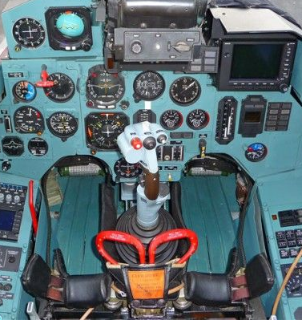
Server Metrics
Error logs, off by default
Cumulative Statistics System
Reset on crash, failover, or point in time restore
Can be manually reset
Aggregations only

Slide 227
Cumulative Statistics System
pg_stat_activity – current activity on server
pg_stat_database – activity & size of database
pg_stat_*_tables – activity & size of table
all
sys
user
pg_stat_*_indexes – guess
pg_statio_*_tables – specific info on blocks & storage

Slide 228
Query Metrics
EXPLAIN ANALYZE
pg_stat_statements
Disabled by default

Slide 229
DEMO!

Slide 230

PASS Session
Professional PostgreSQL Monitoring Made Easy
📅 Wednesday, Nov. 19
⌚ 11:30-12:30
🏢 Room 331-332

Slide 231
Performance Tuning

Slide 232
Cost-based Optimizer
Statistics determine plan choice
Customizable per server, table, and column
Asynchronous process maintains statistics
Manually update with ANALYZE

Slide 233
Statistics
Histogram of column values
Defaults to 100 buckets
Helpful views:
pg_catalog.pg_stats
pg_catalog.pg_stat_user_tables

Slide 234
EXPLAIN in Practice
EXPLAIN = Estimated plan
EXPLAIN ANALYZE = Actual plan
EXPLAIN (ANALYZE,BUFFERS)
Query plan with disk IO
EXPLAIN (ANALYZE,BUFFERS,VERBOSE)
Additional details on columns, schemas, etc.

Slide 235
EXPLAIN
Inverted tree representation
There is no built-in visual execution plan
EXPLAIN provides textual plan
pgAdmin and some others do attempt some visualizations
Websites for visualizations and suggestions
https://www.pgmustard.com/
https://explain.depesz.com/

Slide 236
Reading EXPLAIN
--> Nodes
Read inside-out
Join/Aggregate/Merge/Append at each level

Slide 237
EXPLAIN (ANALYZE, BUFFERS)
SELECT customer_name, count(*), date_part('year',order_date)::int order_year
FROM sales.orders o
INNER JOIN sales.customers c ON o.customer_id=c.customer_id
WHERE c.customer_id=100
GROUP BY customer_name,order_year
ORDER BY order_year DESC;
GroupAggregate (cost=1827.91..1830.76 rows=102 width=35) (actual time=11.956..13.754 rows=4 loops=1)
Group Key: ((date_part('year'::text, (o.order_date)::timestamp without time zone))::integer), c.customer_name
Buffers: shared hit=903
-> Sort (cost=1827.91..1828.18 rows=107 width=27) (actual time=11.700..12.686 rows=107 loops=1)
Sort Key: ((date_part('year'::text, (o.order_date)::timestamp without time zone))::integer) DESC, c.customer_name
Sort Method: quicksort Memory: 33kB
Buffers: shared hit=903
-> Nested Loop (cost=0.28..1824.30 rows=107 width=27) (actual time=0.113..10.649 rows=107 loops=1)
Buffers: shared hit=903
-> Index Scan using pk_sales_customers on customers c (cost=0.28..2.49 rows=1 width=27)
Index Cond: (customer_id = 100)
Buffers: shared hit=3
-> Seq Scan on orders o (cost=0.00..1819.94 rows=107 width=8) (actual time=0.053..8.413 rows=107 loops=1)
Filter: (customer_id = 100)
Rows Removed by Filter: 73488
Buffers: shared hit=900
Planning Time: 0.267 ms
Execution Time: 13.934 ms

Slide 238
GroupAggregate (cost=1827.91..1830.76 rows=102 width=35)
(actual time=11.956..13.754 rows=4 loops=1)
Group Key: ((date_part('year'::text, (o.order_date)::timestamp without time zone))::integer), c.customer_name
Buffers: shared hit=903
-> Sort (cost=1827.91..1828.18 rows=107 width=27) (actual time=11.700..12.686 rows=107 loops=1)
Sort Key: ((date_part('year'::text, (o.order_date)::timestamp without time zone))::integer) DESC, c.customer_name
Sort Method: quicksort Memory: 33kB
Buffers: shared hit=903
-> Nested Loop (cost=0.28..1824.30 rows=107 width=27) (actual time=0.113..10.649 rows=107 loops=1)
Buffers: shared hit=903
-> Index Scan using pk_sales_customers on customers c (cost=0.28..2.49 rows=1 width=27)
Index Cond: (customer_id = 100)
Buffers: shared hit=3
-> Seq Scan on orders o (cost=0.00..1819.94 rows=107 width=8) (actual time=0.053..8.413 rows=107 loops=1)
Filter: (customer_id = 100)
Rows Removed by Filter: 73488
Buffers: shared hit=900
Planning Time: 0.267 ms
Execution Time: 13.934 ms

Slide 239
Primary Scan nodes
Sequence scan (seq scan)
Index scan
Index-only scan

Slide 240
Primary join nodes
Nested Loop
Hash Join
Merge Join
Explain Glossary: https://www.pgmustard.com/docs/explain

Slide 241
Other nodes
Aggregate
Append
Sort
Group
Window Aggregate
More…
Explain Glossary: https://www.pgmustard.com/docs/explain

Slide 242
EXPLAIN (ANALYZE, BUFFERS)
SELECT customer_name, count(*), date_part('year',order_date)::int order_year
FROM sales.orders o
INNER JOIN sales.customers c ON o.customer_id=c.customer_id
WHERE c.customer_id=100
GROUP BY customer_name,order_year
ORDER BY order_year DESC;
GroupAggregate (cost=119.25..122.10 rows=102 width=35) (actual time=5.175..7.109 rows=4 loops=1)
Group Key: ((date_part('year'::text, (o.order_date)::timestamp without time zone))::integer), c.customer_name
Buffers: shared hit=97 read=2
-> Sort (cost=119.25..119.51 rows=107 width=27) (actual time=4.922..5.864 rows=107 loops=1)
Sort Key: ((date_part('year'::text, (o.order_date)::timestamp without time zone))::integer) DESC, c.customer_name
Sort Method: quicksort Memory: 33kB
Buffers: shared hit=97 read=2
-> Nested Loop (cost=2.50..115.64 rows=107 width=27) (actual time=0.199..3.903 rows=107 loops=1)
Buffers: shared hit=97 read=2
-> Index Scan using pk_sales_customers on customers c (cost=0.28..) (actual time=0.028..0.047 rows=1 loops=1)
Index Cond: (customer_id = 100)
Buffers: shared hit=3
-> Bitmap Heap Scan on orders o (cost=2.22..111.28 rows=107 width=8) (actual time=0.127..1.585 rows=107 loops=1)
Recheck Cond: (customer_id = 100)
Heap Blocks: exact=94
Buffers: shared hit=94 read=2
-> Bitmap Index Scan on ix_orders_customer_id (cost=0.00..) (actual time=0.076..0.084 rows=107 loops=1)
Index Cond: (customer_id = 100)
Buffers: shared read=2
Planning Time: 0.653 ms
Execution Time: 7.287 ms

Slide 243
pg_stat_statement
MUST HAVE Extension for query analysis
Installed in all/most DBaaS offerings
Does not save plans or provide recommendations
Allows you to do triage: “Is this a big query issue, or death by 1,000 small cuts?”

Slide 244
pg_stat_statement statistics
Execution Time (total/min/max/mean/stddev)
Planning Time (total/min/max/mean/stddev)
Calls (total)
Rows (total)
Buffers (shared/local/temp)
read/hit/dirtied/written
read/write time
WAL

Slide 245
52 Columns of data (as of PG18)

Slide 246
Name |Value
-------------------+-----------------------
userid |16422
dbid |16434
queryid |-6155333619461995114
query |SELECT id, name FROM...
plans |0
total_plan_time |0.0
min_plan_time |0.0
max_plan_time |0.0
mean_plan_time |0.0
stddev_plan_time |0.0
calls |151
total_exec_time |8.489053
min_exec_time |0.013751
max_exec_time |1.356096
mean_exec_time |0.056218894039735096
stddev_exec_time |0.11851139585068957
rows |151
shared_blks_hit |450
shared_blks_read |3

Slide 247
All statistics are cumulative from the last restart*
*or reset by a superuser

Slide 248
pg_stat_statement: total time w/ cache hit ratio
SELECT query, calls, total_time, rows,
100.0 * shared_blks_hit/nullif(shared_blks_hit + shared_blks_read, 0)
AS hit_percent
FROM pg_stat_statements
ORDER BY total_time DESC
LIMIT 5;
-[ RECORD 1 ]--------------------------------------------------------------------- query | SELECT * FROM sales.orders where customer_id = ?
calls | 1000
total_time | 2451.00000000000
Rows. | 521
hit_percent | 99.9873421
*Lots of good videos/tutorials, but also see the docs for more help and ideas.

Slide 249

PASS Session
Mastering PostgreSQL Performance
📅 Thursday, Nov. 20
⌚ 4:15-5:30
🏢 Room 327-328

Slide 250
PostgreSQL and the Cloud

Slide 251
The Big 3 (in alphabetical order)
Amazon Web Services (AWS)
Google Cloud Platform (GCP)
Microsoft Azure (Azure)

Slide 252

Anyone EXCEPT Them
IBM Cloud (yeah, who knew)
Heroku
EnterpriseDB
Rackspace
Kamatera
Vultr
DigitalOcean
Linode
OVHcloud

Slide 253
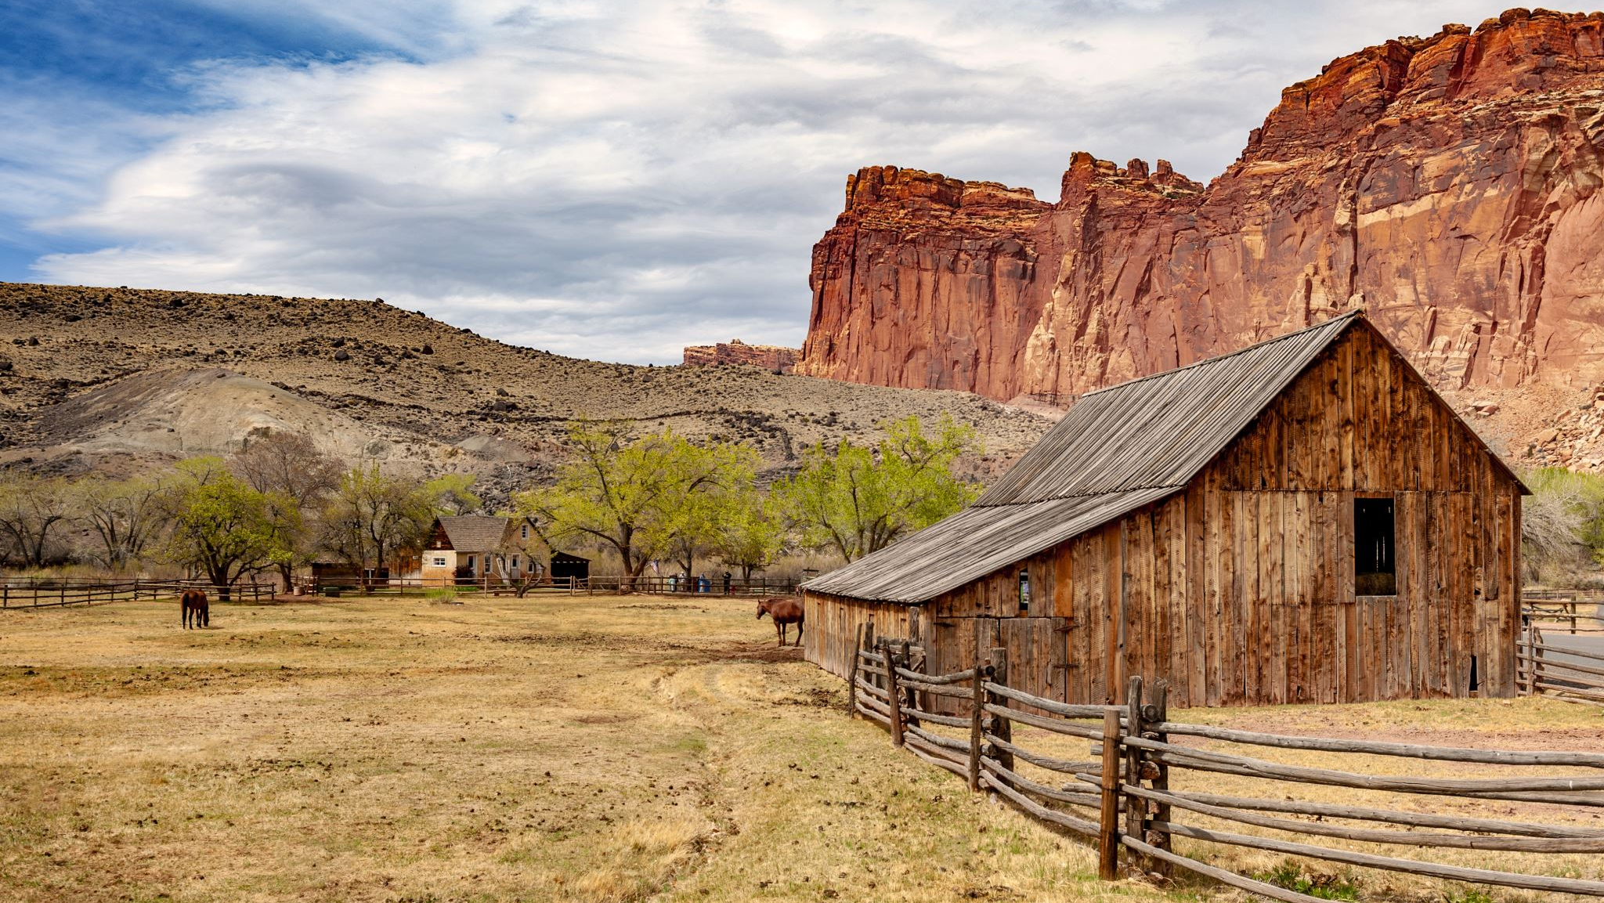
Meanwhile, back at the ranch…

Slide 254

Common to Big Three Cloud Providers
No OS
Defined SLA
Backups are handled
Integrity is handled
Internals are up to you
Some of level of HA/DR built in
Limitations on extensions
Data is encrypted at rest and in motion

Slide 255

AWS RDS PostgreSQL
PostgreSQL versions 13 – 17 (18 in preview)
Secured through Amazon Virtual Private Cloud
Secondary availability zones and read only secondaries

Slide 256

AWS Aurora PostgreSQL
Maintained fork of PostgreSQL
Versions supported: 13-17
Mostly the same as RDS
Automatically in three (3) availability zones at no added cost
Enhanced I/O

Slide 257

GCP CloudSQL for PostgreSQL
Versions 13-17 of PostgreSQL (18 in preview)
Replication with failover is supported
Query monitoring
Explain plans available

Slide 258
GCP AlloyDB for PostgreSQL
Maintained fork of PostgreSQL
Key word, “Compatible”
Available both in the cloud and on-prem
Actually a cluster of Virtual Machines

Slide 259

Azure Database for PostgreSQL
Supports versions 12 – 17 (18, yes, in preview)
Customized extensions
Query Store
Multiple levels of security including Kerberos
Additional HA/DR scenarios available
Readable secondaries

Slide 260

PASS Session
Modernizing workloads from SQL Server to PostgreSQL with Amazon Aurora
📅 Wednesday, Nov. 19
⌚ 11:30-12:30
🏢 Room 327-328

Slide 261

PASS Session
Oracle to Amazon PostgreSQL Aurora
📅 Thursday, Nov. 20
⌚ 4:15-5:30
🏢 Room 327-328

Slide 262

PASS Session
PostgreSQL On Google Cloud
📅 Friday, Nov. 21
⌚ 11:30-12:30
🏢 Room 331-332

Slide 263
Additional Resources

Slide 264

PostgreSQL Documentation
https://www.postgresql.org/docs/
Pay attention to this:
https://www.postgresql.org/docs/ current/dml-delete.html

Slide 265
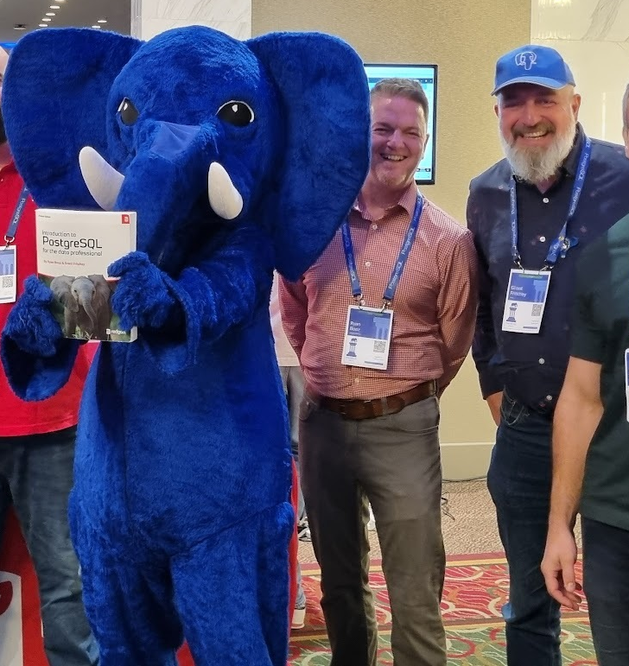
Books
Introduction to PostgreSQL – Ryan Booz, Grant Fritchey
Art of PostgreSQL – Dimitri Fontaine
Database Administration – Craig Mullins
PostgreSQL Query Optimization - Henrietta Dombrovskaya, Boris Novikov and Anna Bailliekova

Slide 266

Other Events
PostgreSQL User Groups (PUG)
MeetUp
PGDay
pgConf (same link as PGDay)

Slide 267

Online
Planet PostgreSQL
PostgreSQL Slack
Cooper Press Email List
#pghelp on X
Usual suspects

Slide 268
https://github.com/ScaryDBA/RedgatePrecon2025

Slide 269
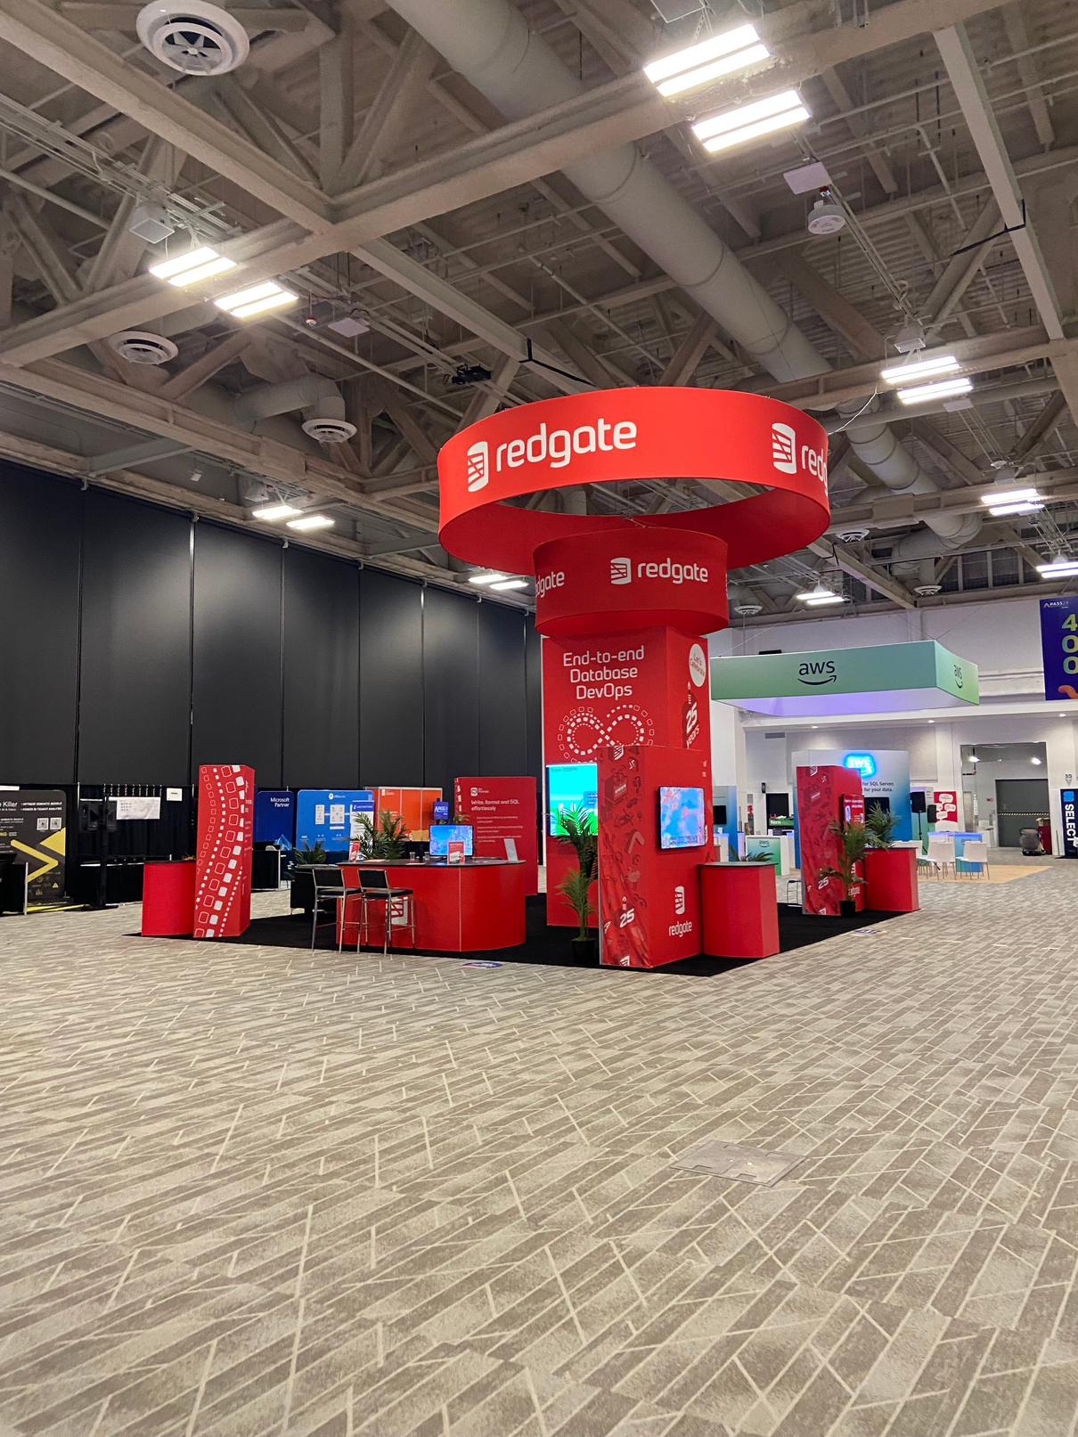







Join us at the Redgate Booth!
Complete your Advocate LEGO Collection
with the brand-new Kellyn Minifigure
Play Whack-a-Mole for a chance to win
a Nintendo Switch 2!
Take a Brain Break
Come and build some LEGO!

Slide 270

Calling All
PostgreSQL Users
Whether you’re a pro or just getting started, Redgate would love to hear your PostgreSQL insights and pain points
Together, we’ll co-design the future of PostgreSQL tools and make development smoother for everyone!

